Slide 1
IITP 지능형 6G 무선 액세스 시스템
Physics-Based Modeling for
AI-Oriented Resource Allocation
Sang Hyun Lee
Korea University

Slide 2
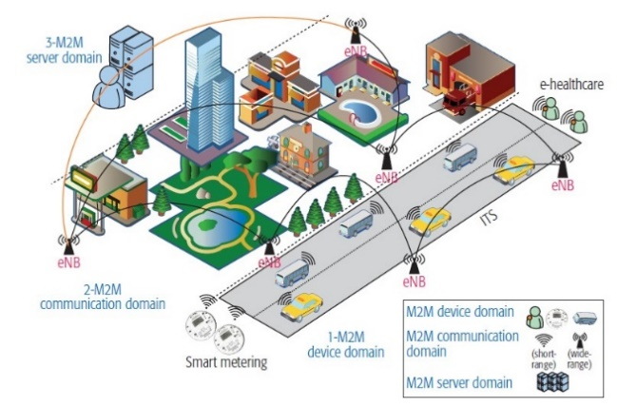
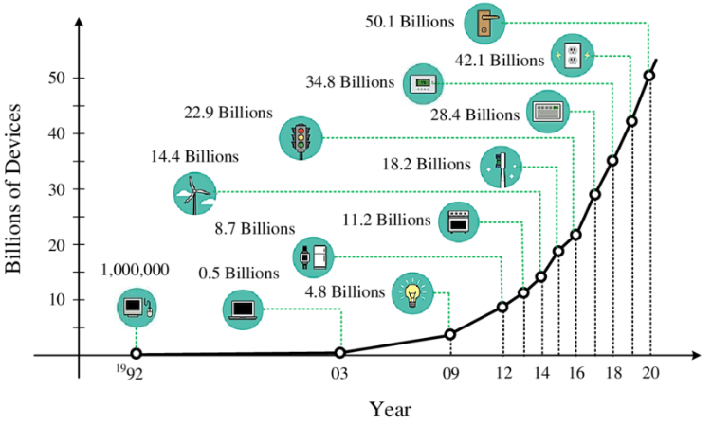
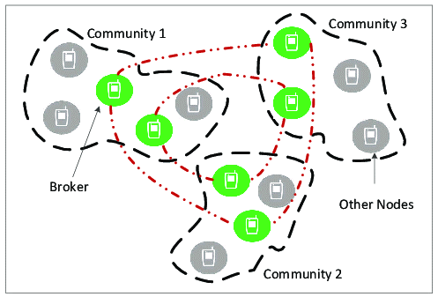
1 Introduction & motivations
Future wireless communications
Quantitative goals
High bandwidth delivery
Low latency
High connection density
“Social” characteristics of network node populations
Dominance of personal devices and data
Formation of communities around hub nodes
Discrepancy between physical and social proximities

Slide 3
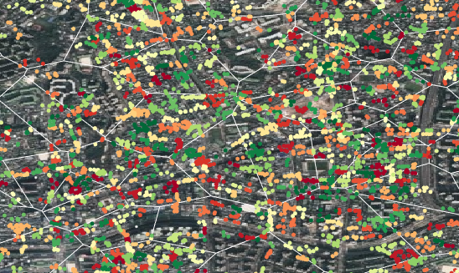
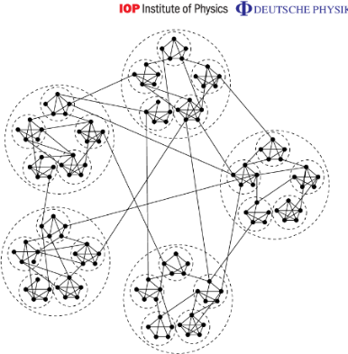
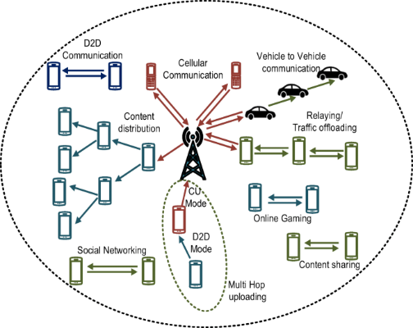
1 Introduction & motivations
Intelligent management upon network scale-up
Exploitation of proximity properties
Automated low-complexity computing
AI-assisted handling strategy
Fast and adaptive optimization
AI-assisted optimizer

Slide 4
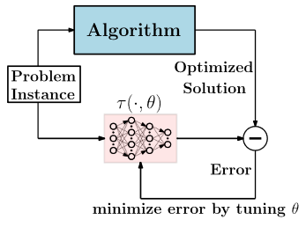
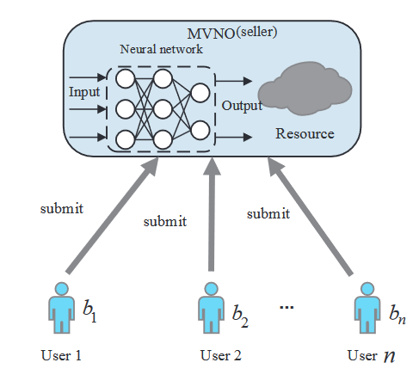
1 Introduction & motivations
AI-assisted optimization examples
Supervised training of algorithm solutions
ex. DNN for WMMSE ^{(Sun18)}
Dataset prepared with exact solution instances
Solution depending on training error tolerance
Unsupervised learning with objective function
ex. DNN for revenue-optimal auction ^{(Zhu20)}
Training objective while enforcing constraints
Handling only averaged constraints and objectives
Sun et al "Learning to Optimize: Training Deep Neural Networks for Interference Management" IEEE Trans SP 2018
Zhu et al "Revenue-Optimal Auction For Resource Allocation in Wireless Virtualization: A Deep Learning Approach" IEEE Trans MC 2020

Slide 5
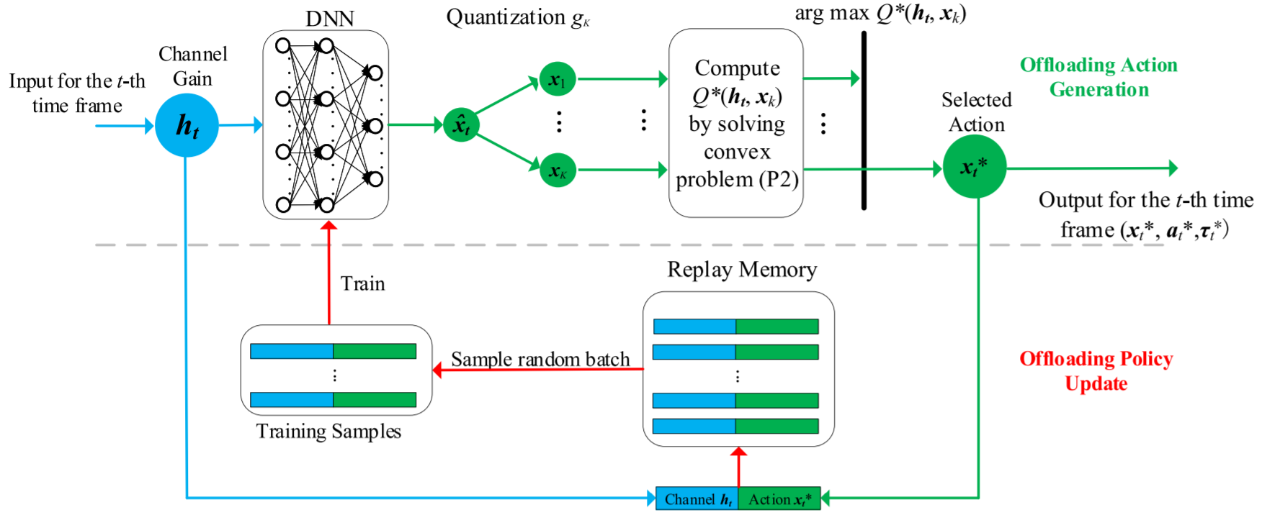
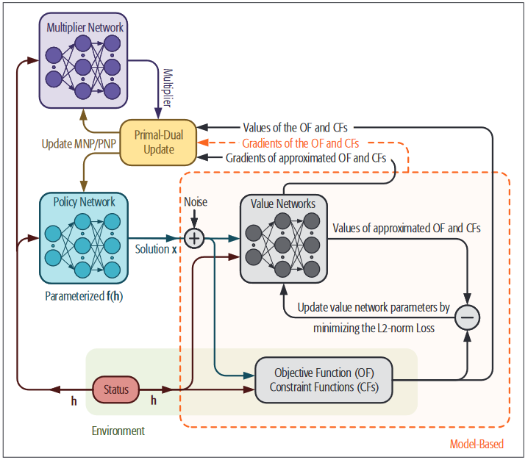
1 Introduction & motivations
-
--
Reinforcement learning based optimization ex. Policy exploration ^{(Huang19)}
Handcrafted reward functions
Complementary slackness (“tightness”) issues
Consideration of instantaneous constraints
ex. Reinforced-unsupervised deep learning ^{(Liu20)}
Additional DNN to train inst. constraints
Underfitting in objective value still present
AI-assisted approaches
Huang et al, "Deep Reinforcement Learning for Online Computation Offloading in Wireless Powered Mobile-Edge Computing Networks" IEEE Trans MC 2019
Liu et al, "Optimizing Wireless Systems Using Unsupervised and Reinforced-Unsupervised Deep Learning" IEEE Network 2020

Slide 6
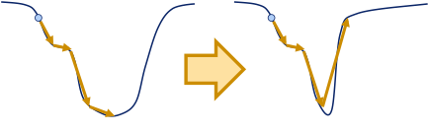
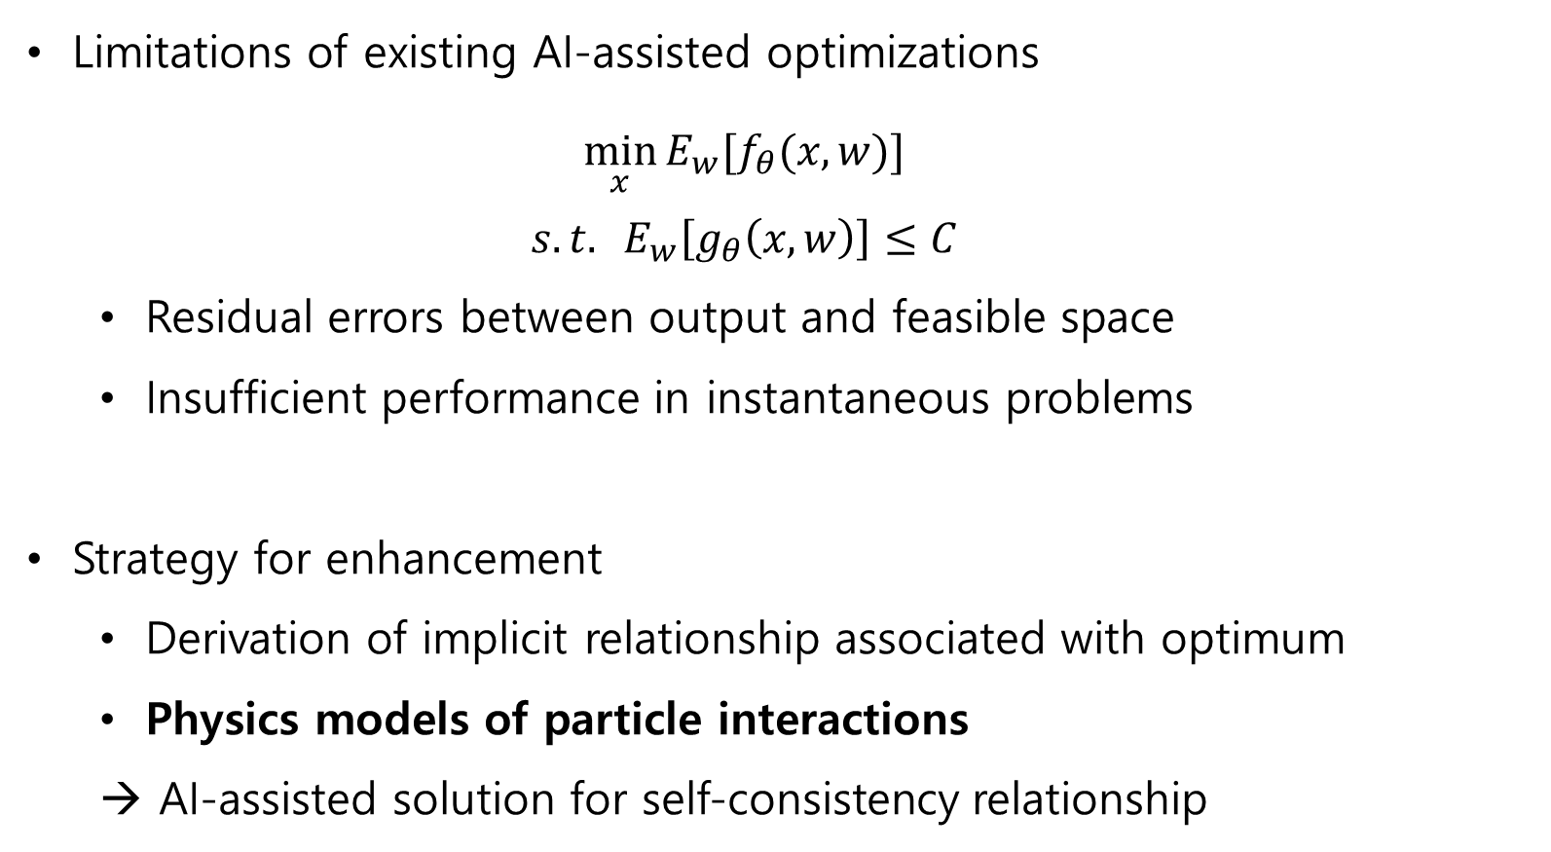
1 Introduction & motivations
Limitations of existing AI-assisted optimizations
$$\min_{x}{{E_{w}[f}_{θ}(x,w)]}$$
$$s.t. E_{w}\left[g_{θ}\left(x,w\right)\right]≤C$$
Residual errors between output and feasible space
Insufficient performance in instantaneous problems
Strategy for enhancement
Derivation of implicit relationship associated with optimum
Physics models of particle interactions
→ AI-assisted solution for self-consistency relationship

Slide 7
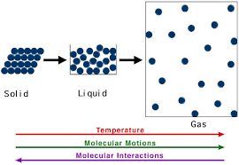
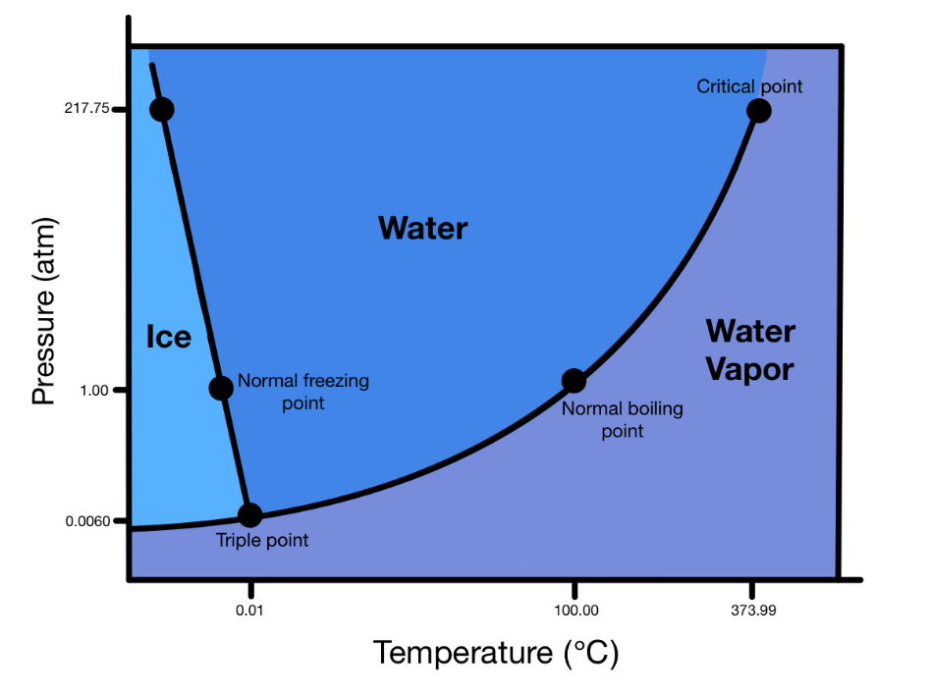
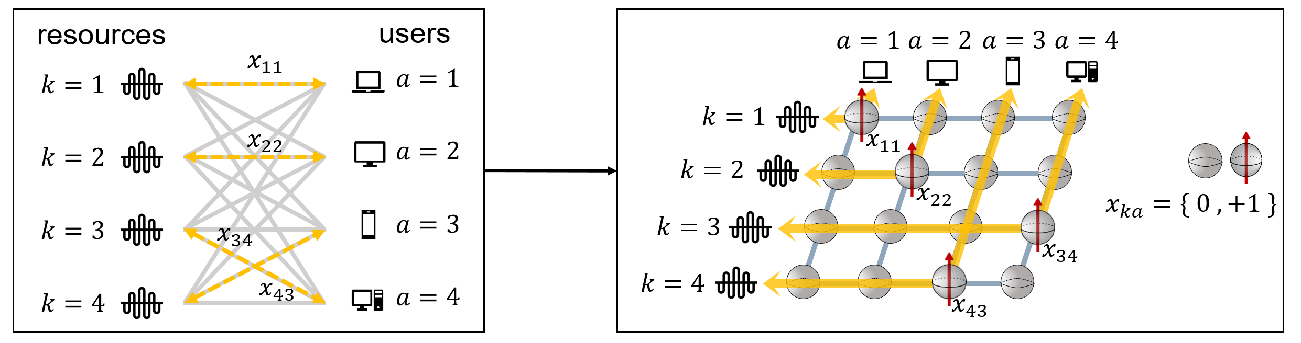
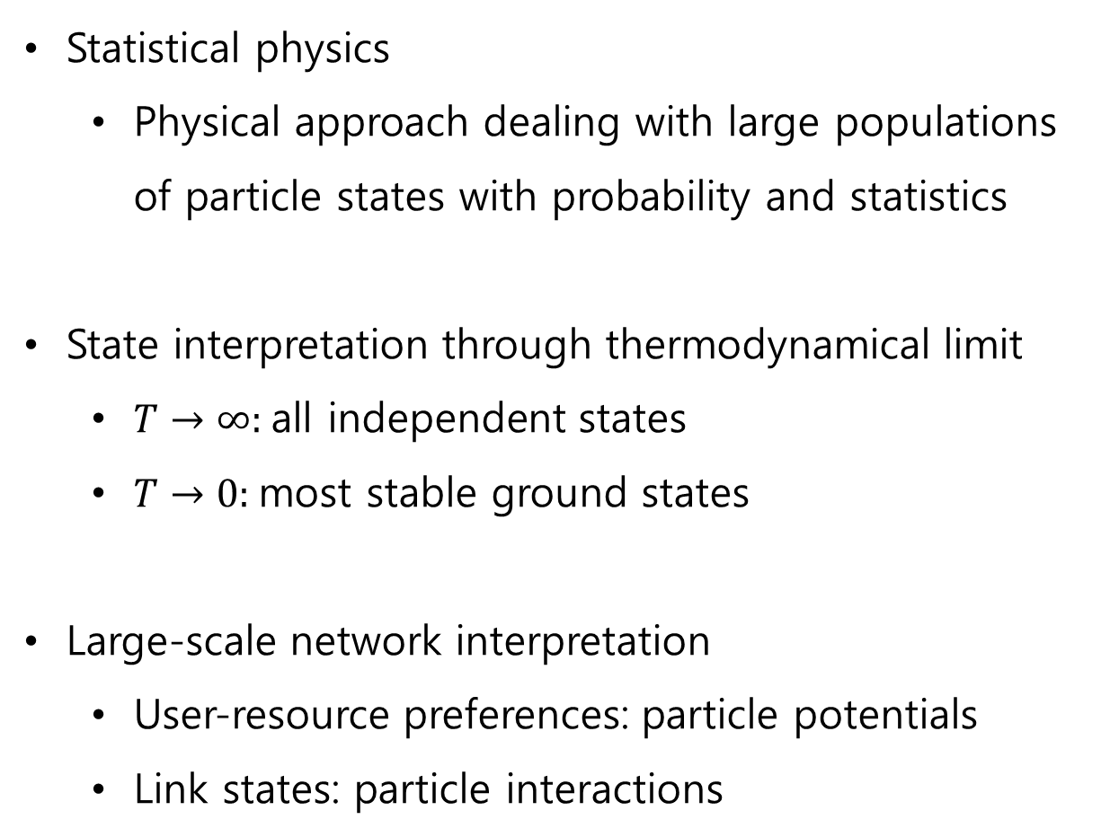
2 Physics model of resource allocation
Statistical physics
Physical approach dealing with large populations of particle states with probability and statistics
State interpretation through thermodynamical limit
$T→∞$: all independent states
$T→0$: most stable ground states
Large-scale network interpretation
User-resource preferences: particle potentials
Link states: particle interactions

Slide 8
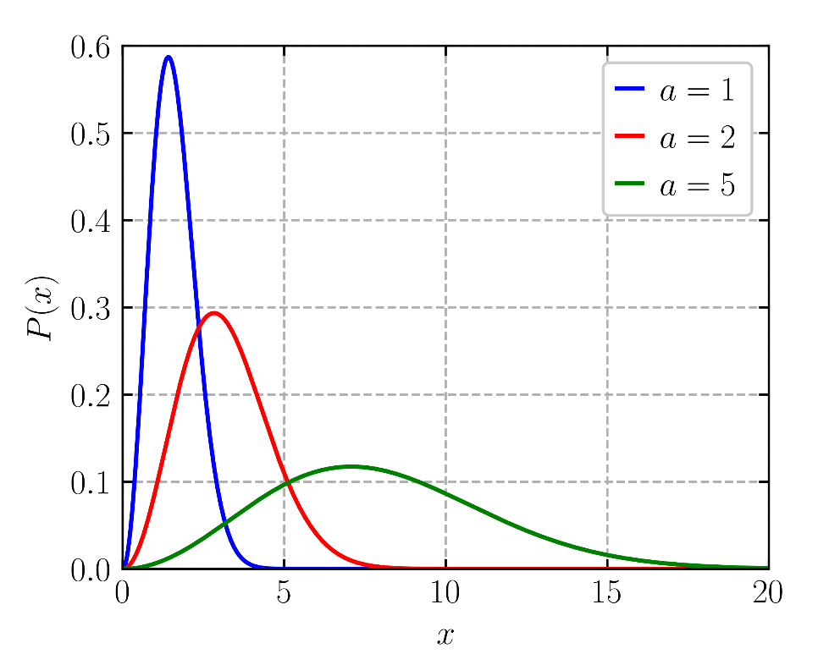
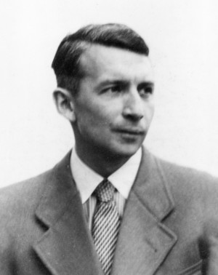

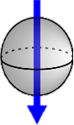
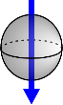

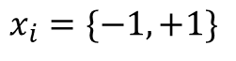
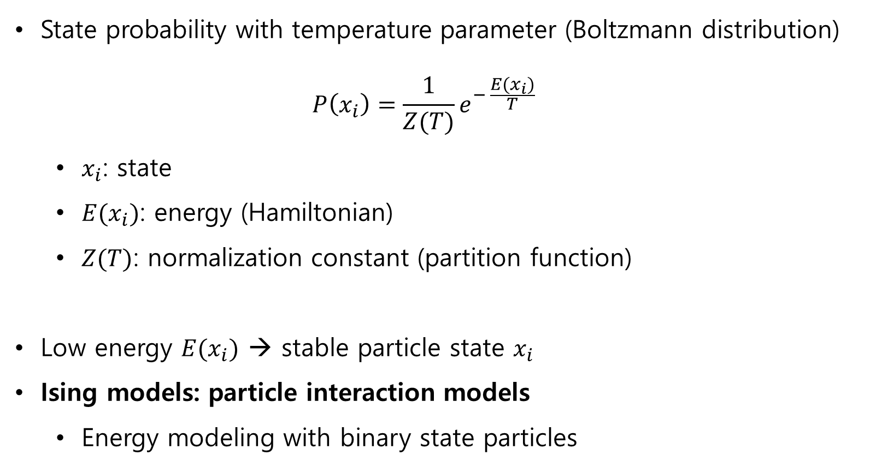
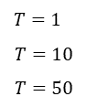
2 Physics model of resource allocation
State probability with temperature parameter (Boltzmann distribution)
$$P\left(x_{i}\right)=\frac{1}{Z(T)}e^{− \frac{E(x_{i})}{T}}$$
$x_{i}$: state
$E(x_{i})$: energy (Hamiltonian)
$Z(T)$: normalization constant (partition function)
Low energy $E(x_{i})$ → stable particle state $x_{i}$
Ising models: particle interaction models
Energy modeling with binary state particles
$T=1$
$$T=10$$
$$T=50$$
$$x_{i}=\{−1, +1\}$$
Ernst Ising 1900-1998

Slide 9
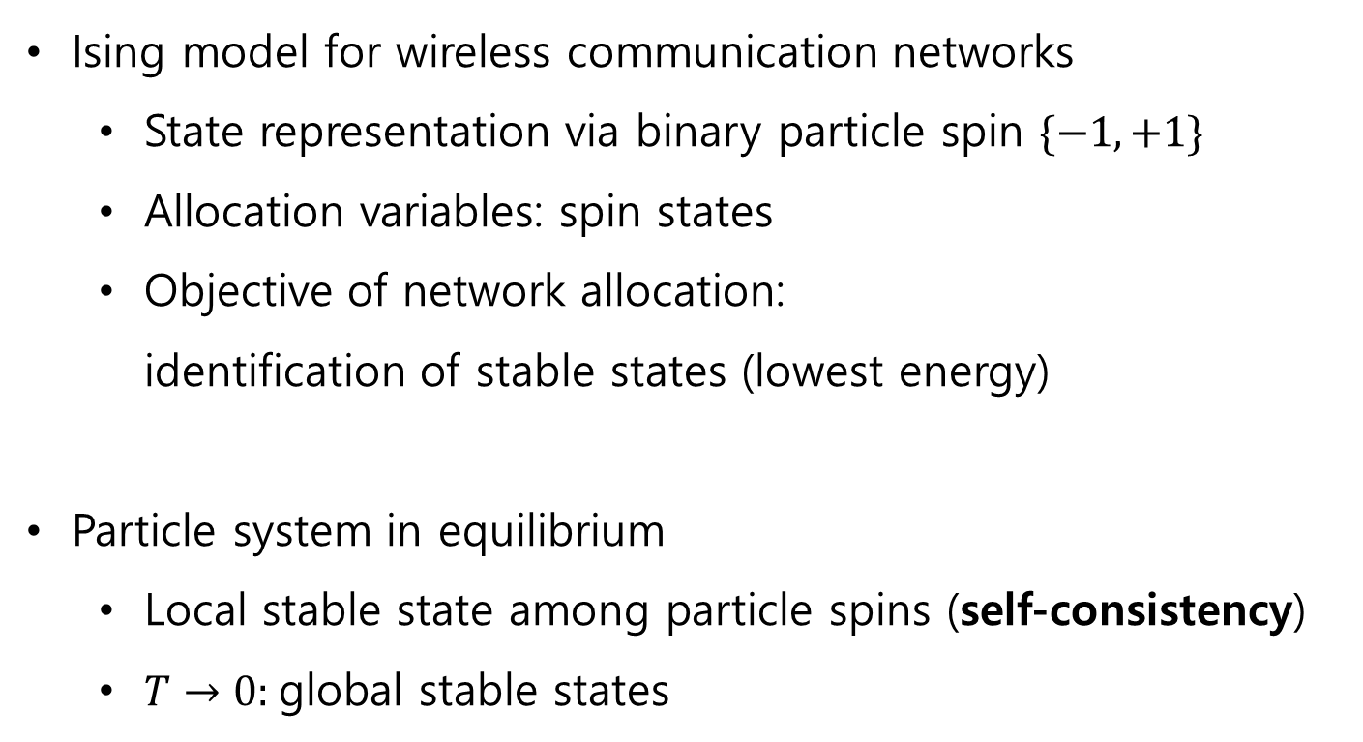
2 Physics model of resource allocation
Ising model for wireless communication networks
State representation via binary particle spin $\{−1, +1\}$
Allocation variables: spin states
Objective of network allocation: identification of stable states (lowest energy)
Particle system in equilibrium
Local stable state among particle spins (self-consistency)
$T→0$: global stable states
$$x_{i}=\{−1, +1\}$$

Slide 10


2 Physics model of resource allocation
Math models for obtaining self-consistency
Collective handling of large particle population
Mean field theory ^{(PRML)}
Interaction b/w single spin and surroundings
Bethe approximation ^{(Yedidia05)}
Interaction b/w single spin and adjacent neighbors
Bishop Pattern recognition and machine learning springer 2006
Yedidia "Constructing free-energy approximations and generalized belief propagation algorithms" IEEE Trans IT 2005
Notes:
PRML
J. S. Yedidia, W. T. Freeman and Y. Weiss, "Constructing free-energy approximations and generalized belief propagation algorithms," in IEEE Transactions on Information Theory, vol. 51, no. 7, pp. 2282-2312, July 2005, doi: 10.1109/TIT.2005.850085.

Slide 11
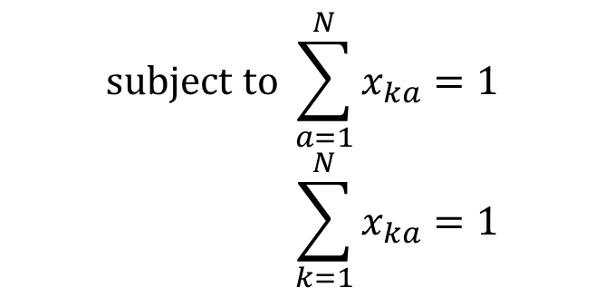
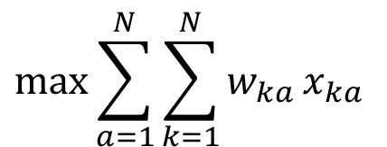
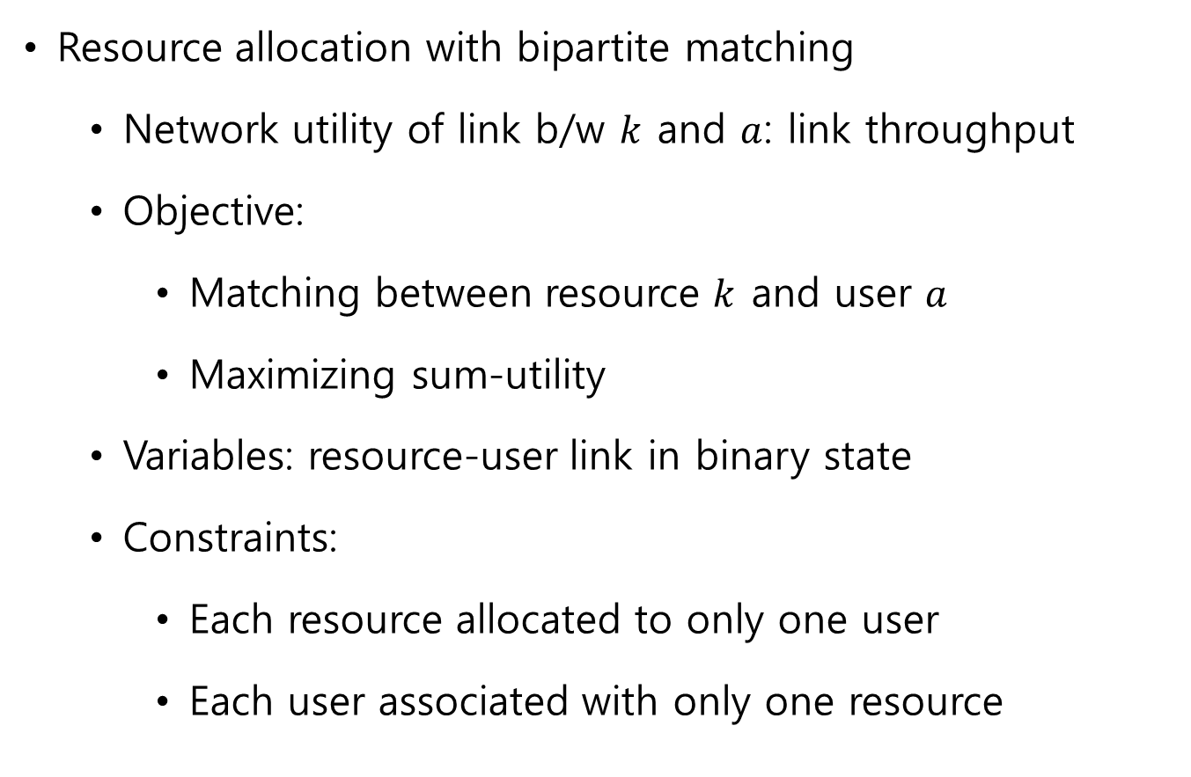
2 Physics model of resource allocation
Resource allocation with bipartite matching
Network utility of link b/w $k$ and $a$: link throughput
Objective:
Matching between resource $k$ and user $a$
Maximizing sum-utility
Variables: resource-user link in binary state
Constraints:
Each resource allocated to only one user
Each user associated with only one resource
$$\max{\sum_{a=1}^{N}{\sum_{k=1}^{N}{w_{ka}}}}x_{ka}$$
$$subject to \sum_{a=1}^{N}{x_{ka}}=1 \\ \sum_{k=1}^{N}{x_{ka}}=1$$

Slide 12





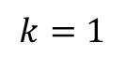

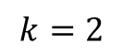
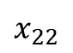
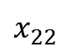
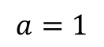
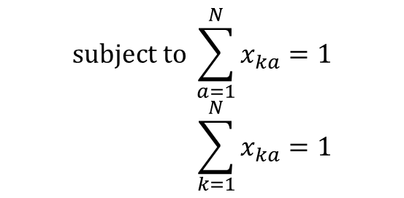
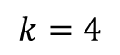
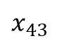
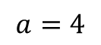
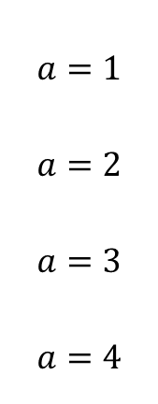
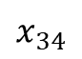
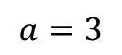
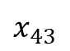
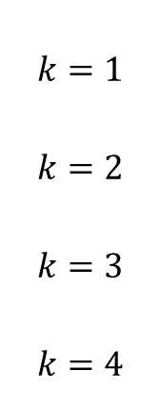
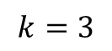
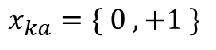
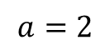
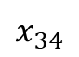
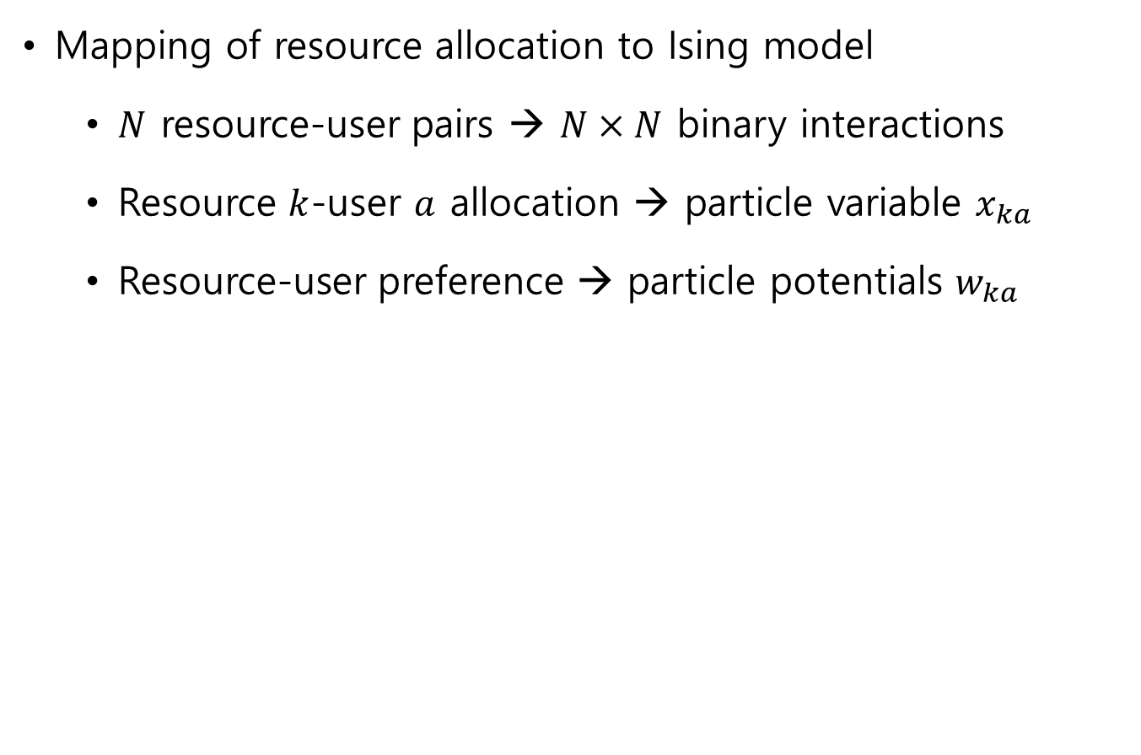
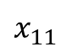
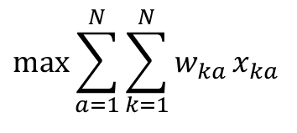
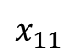
2 Physics model of resource allocation
Mapping of resource allocation to Ising model
$N$ resource-user pairs → $N×N$ binary interactions
Resource $k$-user $a$ allocation → particle variable $x_{ka}$
Resource-user preference → particle potentials $w_{ka}$
$$\max{\sum_{a=1}^{N}{\sum_{k=1}^{N}{w_{ka}}}}x_{ka}$$
$$subject to \sum_{a=1}^{N}{x_{ka}}=1 \\ \sum_{k=1}^{N}{x_{ka}}=1$$
resources
users
$$a=1$$
$$a=2$$
$$a=3$$
$$a=4$$
$$k=1 \\ k=2 \\ k=3 \\ k=4$$
$$x_{11}$$
$$a=1 \\ a=2 \\ a=3 \\ a=4$$
$$k=1$$
$$x_{22}$$
$$x_{11}$$
$$k=2$$
$$x_{22}$$
$$x_{ka}=\{ 0 , +1 \}$$
$$x_{34}$$
$$k=3$$
$$x_{34}$$
$$x_{43}$$
$$k=4$$
$$x_{43}$$

Slide 13

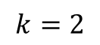














2 Physics model of resource allocation
Energy modeling of sum-utility maximization
$$E\left(x\right)=−\sum_{a}{\sum_{k}{w_{ka}x_{ka}}}$$
$$=−\sum_{a}{\sum_{k}{\frac{w_{ka}}{2}x_{ka}}}−\sum_{a}{\sum_{k}{\frac{w_{ka}}{2}x_{ka}}}$$
$$=−\sum_{a}{E_{a}\left(x_{a}\right)}−\sum_{k}{E_{k}(x_{k})}$$
$$a=1$$
$$a=2$$
$$a=3$$
$$a=4$$
$$k=1$$
$$x_{11}$$
global objective
$$k=2$$
$$x_{22}$$
$$x_{ka}=\{ 0 , +1 \}$$
$$k=3$$
$$x_{34}$$
$$k=4$$
$$x_{43}$$
two groups w.r.t users and resources
$x_{a}=\left\{x_{ja}:j∈[1,…,N]\right\}$
$x_{k}=\left\{x_{kb}:k∈\left[1,…,N\right]\right\}$

Slide 14




2 Physics model of resource allocation
Resulting joint Boltzmann distribution with energy model
Represented in product of marginals associated with user and resource groups
$$P\left(x\right)=\frac{1}{Z\left(T\right)}⋅e^{−\frac{\sum_{a}{E_{a}\left(x_{a}\right)}}{T}}\prod_{a}{\left[𝕀\left[\sum_{k}{x_{ka}=1}\right]\right]}⋅e^{−\frac{\sum_{k}{E_{k}\left(x_{k}\right)}}{T}}\prod_{k}{\left[𝕀\left[\sum_{a}{x_{ka}=1}\right]\right]}$$
User marginals
Resource marginals
$$a$$
$$k$$
$$𝕀\left[s\right]=\left\{\begin{aligned}1, s is true \\ & 0, s is false\end{aligned}\right.$$

Slide 15








3 Self-consistency in resource allocation
Global stable states with collection of marginals for $x_{ka}$
Marginal distribution of $x_{ka}$
$P_{ka}^{\left(a\right)}\left(x_{ka}\right)$: user marginal for user $a$
$P_{ka}^{\left(k\right)}\left(x_{ka}\right)$: resource marginal for resource $k$
$Z_{ka}\left(T\right)$: constant aggregating other links
$$P\left(x_{ka}\right)=\sum_{x\backslash x_{ka}}{P\left(x\right)}=\sum_{x_{k}\backslash x_{ka}}{ \sum_{x_{a}\backslash x_{ka}}{P\left(x\right)}}≡\frac{P_{ka}^{\left(a\right)}\left(x_{ka}\right)P_{ka}^{\left(k\right)}\left(x_{ka}\right)}{Z_{ka}\left(T\right)}$$
$$a$$
$$k$$
$$P_{ka}^{\left(k\right)}\left(x_{ka}\right)$$
$$Z_{ka}\left(T\right)$$
$$P_{ka}^{\left(a\right)}\left(x_{ka}\right)$$

Slide 16












3 Self-consistency in resource allocation
$$a$$
User marginal $a$ with Bethe approximation
$$P_{ka}^{\left(a\right)}\left(x_{ka}\right)=\sum_{x_{k}\backslash x_{ka}}{P\left(x\right)}$$
$$=\frac{e^{\frac{w_{ka}x_{ka}}{2T}}}{Z_{ka}^{\left(a\right)}\left(T\right)}⋅\sum_{x_{k}\backslash x_{ka}}{\left[𝕀\left[x_{ka}+\sum_{b≠a}{x_{jb}=1}\right]\prod_{b≠a}{e^{\frac{w_{kb}x_{kb}}{2T}}}P_{kb}^{\left(k\right)}\left(x_{kb}\right)\right]}$$
Resource marginal $k$ with Bethe approximation
$$=\prod_{b≠a}{P\left(x_{kb}\right)}$$
$$P_{ka}^{\left(k\right)}\left(x_{ka}\right)=\frac{e^{\frac{w_{ka}x_{ka}}{2T}}}{Z_{ka}^{\left(k\right)}\left(T\right)}⋅\sum_{x_{a}\backslash x_{ka}}{\left[𝕀\left[x_{ka}+\sum_{j≠k}{x_{ja}=1}\right]\prod_{j≠k}{e^{\frac{w_{ja}x_{ja}}{2T}}}P_{ja}^{\left(a\right)}\left(x_{ja}\right)\right]}$$
$$k$$
$$=\prod_{j≠k}{P\left(x_{ja}\right)}$$

Slide 17



3 Self-consistency in resource allocation
Marginal probabilities expressed in ratios
$e^{−\frac{A_{ka}}{T}}≡\frac{P_{ka}^{\left(a\right)}\left(x_{ka}=0\right)}{P_{ka}^{\left(a\right)}\left(x_{ka}=1\right)}$, $e^{−\frac{R_{ka}}{T}}≡\frac{P_{ka}^{\left(k\right)}\left(x_{ka}=0\right)}{P_{ka}^{\left(k\right)}\left(x_{ka}=1\right)}$
$P_{ka}^{\left(a\right)}\left(x_{ka}=1\right)$: Pr(no other link allowed to user $a$)
$P_{ka}^{\left(a\right)}\left(x_{ka}=0\right)$: Pr(another link of resource $j$ made to user $a$)
$A_{ka}$ expressed by $R_{kb}$
$$a$$
$$e^{−\frac{A_{ka}}{T}}=\frac{\sum_{b≠a}{e^{\frac{w_{kb}}{2T}}}P_{kb}^{\left(k\right)}\left(x_{kb}=1\right)\prod_{c≠\left\{a , b\right\}}{P_{kc}^{\left(k\right)}\left(x_{kc}=0\right)}}{e^{\frac{w_{ka}}{2T}\prod_{b≠a}{P_{kb}^{\left(k\right)}\left(x_{kb}=0\right)}}} \\ =e^{−\frac{w_{ka}}{2T}}\sum_{b≠a}{e^{\frac{w_{kb}}{2T}}\frac{P_{kb}^{\left(k\right)}\left(x_{kb}=1\right)}{P_{kb}^{\left(k\right)}\left(x_{kb}=0\right)}} \\ {=e}^{−\frac{w_{ka}}{2T}}\sum_{b≠a}{e^{\frac{1}{T}\left(R_{kb}+\frac{w_{kb}}{2}\right)}}$$
expressed by $R_{kb}$

Slide 18





3 Self-consistency in resource allocation
$R_{ka}$ expressed similarly by $A_{ja}$
Resulting self-consistency equations
$$e^{−\frac{R_{ka}}{T}}=e^{−\frac{w_{ka}}{2T}}\sum_{j≠k}{e^{\frac{w_{ja}}{2T}}\frac{P_{ja}^{\left(a\right)}\left(x_{ja}=1\right)}{P_{ja}^{\left(a\right)}\left(x_{ja}=0\right)}} \\ {=e}^{−\frac{w_{ka}}{2T}}\sum_{j≠k}{e^{\frac{1}{T}\left(A_{ja}+\frac{w_{ja}}{2}\right)}}$$
expressed by $A_{ja}$
$$k$$
$$A_{ka}=\frac{w_{ka}}{2}−T\log{\sum_{b≠a}{e^{\frac{1}{T}\left(R_{kb}+\frac{w_{kb}}{2}\right)}}}$$
$$R_{ka}=\frac{w_{ka}}{2}−T\log{\sum_{j≠k}{e^{\frac{1}{T}\left(A_{ja}+\frac{w_{ja}}{2}\right)}}}$$

Slide 19





3 Self-consistency in resource allocation
Thermodynamic limits
$A_{ka}=α_{ka}+Tη_{ka}+O\left(T\right)$
$R_{ka}=ρ_{ka}+Tξ_{ka}+O\left(T\right)$
Approximation via plug-in of limits in self-consistency
Additional notations
Hard fields: $α_{ka}$, $ρ_{ka}$
Soft fields: $η_{ka}$, $ξ_{ka}$
$$α_{ka}+Tη_{ka}+O\left(T\right)=\frac{w_{ka}}{2}−T\log{\sum_{b≠a}{e^{\frac{1}{T}\left(ρ_{kb}+\frac{w_{kb}}{2}+O\left(T\right)\right)+ξ_{kb}}}} \\ =\frac{w_{ka}}{2}−\max_{b≠a}\left(ρ_{kb}+\frac{w_{kb}}{2}\right)−T\log{\sum_{b≠a}{e^{ξ_{kb}}}}+O\left(T\right)$$
Log sum exponent approximation
$$T\log{\sum_{b≠a}{e^{\frac{1}{T}\left(y_{b}\right)}}}≈\max_{b≠a}\left(y_{b}\right)$$
$$ρ_{ka}+Tξ_{ka}+O\left(T\right)=\frac{w_{ka}}{2}−T\log{\sum_{j≠k}{e^{\frac{1}{T}\left(α_{ja}+\frac{w_{ja}}{2}+O\left(T\right)\right)+η_{ja}}}} \\ =\frac{w_{ka}}{2}−\max_{j≠k}\left(α_{ja}+\frac{w_{ja}}{2}\right)−T\log{\sum_{j≠k}{e^{η_{ja}}}}+O\left(T\right)$$

Slide 20





3 Self-consistency in resource allocation
Zero temperature limits ($T→0$)
Convergence to globally optimal states as $T→0$
$$a$$
$$α_{ka}=\frac{w_{ka}}{2}−\max_{b≠a}\left(ρ_{kb}+\frac{w_{kb}}{2}\right) \\ η_{ka}=−\log\left[\sum_{b≠a}{e^{ξ_{kb}}}\right] \\ ρ_{ka}=\frac{w_{ka}}{2}−\max_{j≠k}\left(α_{ja}+\frac{w_{ja}}{2}\right) \\ ξ_{ka}=−\log\left[\sum_{j≠k}{e^{η_{ka}}}\right]$$
$$k$$

Slide 21





3 Self-consistency in resource allocation
Marginal distribution of link variable $x_{ka}$
Link connection probability
Unique optimal state ($T→0$)
Multiple optimal states in case of tie or $α_{ka}+ρ_{ka}=0$
$$P_{T}\left(x_{ka}\right)=P_{ka}^{\left(a\right)}\left(x_{ka}\right)P_{ka}^{\left(k\right)}\left(x_{ka}\right)$$
$$a$$
$$k$$
$$P_{T}\left(x_{ka}=1\right)=P_{ka}^{\left(a\right)}\left(x_{ka}=1\right)P_{ka}^{\left(k\right)}\left(x_{ka}=1\right)∝e^{\frac{A_{ka}+R_{ka}}{T}} \\ =e^{\frac{(α_{ka}+ρ_{ka})}{T}+\left(η_{ka}+ζ_{ka}\right)}$$
$$x_{ka}=\underset{k}{argmax}\left[α_{ka}+ρ_{ka}\right] ∀a$$
$$x_{ka}=\underset{k}{argmax}\left[η_{ka}+ζ_{ka}\right] ∀a$$

Slide 22

4 Computational acceleration via neural networks
Matrix representation of hard fields $ρ_{ka}$, $α_{ka}$
$ρ=[ρ_{ka}]$, $α=[α_{ka}]$
Matrix function representation of self-consistency in terms of $ρ_{ka}$, $α_{ka}$
$ρ_{ka}=\frac{w_{ka}}{2}−\max_{j≠k}\left(α_{ja}+\frac{w_{ja}}{2}\right)$ ➔ $\left[ρ_{ka}\right]=f\left(α,w\right)$
$α_{ka}=\frac{w_{ka}}{2}−\max_{b≠a}\left(ρ_{kb}+\frac{w_{kb}}{2}\right)$ ➔ $\left[α_{ka}\right]=g\left(ρ,w\right)$
Identification of hard fields
Iterative strategy
$ρ^{n+1}=f\left(α^{n},w\right)$, $α^{n+1}=g\left(ρ^{n},w\right)$
Limits convergent to self-consistency ($n→∞$)
$ρ^{∞}=f(α^{∞},w)$, $α^{∞}=g(ρ^{∞},w)$
$$a=1$$
$$a=2$$
$$a=3$$
$$a=4$$
$$k=1$$
$$x_{11}$$
$$k=2$$
$$x_{22}$$
$$x_{ka}=\{ 0 , +1 \}$$
$$k=3$$
$$x_{34}$$
$$k=4$$
$$x_{43}$$

Slide 23







4 Computational acceleration via neural networks
Resource allocation obtained by $α,$ $ρ$ satisfying self-consistency
Neural network representation
Input: $w$
Output:
Self-consistency defined with vector function $φ\left(⋅\right)$:
Cost function $𝒞\left(𝕐,w\right)$ defined with vector function $φ\left(⋅\right)$
$$w$$
$$𝕐$$
$$𝕐=\left[\begin{matrix}ρ \\ α\end{matrix}\right]$$
cost: $MSE[𝕐,φ(𝕐,w))$]
Backpropagation
$$𝕐=φ\left(𝕐,w\right) φ(𝕐,w)=\left[\begin{matrix}f\left(ρ,w\right) \\ g\left(α,w\right)\end{matrix}\right]$$
$$𝒞\left(𝕐,w\right)=\left\|𝕐−φ\left(𝕐,w\right)\right\|$$

Slide 24

4 Computational acceleration via neural networks
Neural network acting as nonlinear equation solver for self-consistency
→ Applicable to generic equation solving
Twofold strategy:
Unsupervised learning (learning to optimize)
Deep reinforcement learning
Notes:
1,2번 디테일 20, 21페이지로 뿌리기

Slide 25







4 Computational acceleration via neural networks
Validation results w.r.t timestep
(UL vs. iterative search)
Unsupervised learning (Learning to optimize)
Input: pairwise preferences
Output: allocation matrix
Training:
forward step
self-consistency eq.
$$\left[\begin{matrix}\overline{α} \\ \overline{ρ}\end{matrix}\right] =\left[\begin{matrix}f(ρ,w) \\ g(α,w)\end{matrix}\right]$$
$\overline{α},\overline{ρ}$
pairwise
preferences
$$W$$
$α,ρ$
cost
$C=MSE[\left(α,ρ\right),(\overline{α}, \overline{ρ})$]
$$∇C$$
backward step

Slide 26









4 Computational acceleration via neural networks
Validation results w.r.t timestep
(RL vs. iterative search)
Reinforced learning
Policy input: pairwise preferences, current state
Policy output: action towards next state
Environment/reward: residual error of equality
Training:
environment
$$\left[\begin{matrix}\overline{α} \\ \overline{ρ}\end{matrix}\right] =\left[\begin{matrix}f(ρ,w) \\ g(α,w)\end{matrix}\right]$$
$${\overline{α}}^{t+1}, {\overline{ρ}}^{t+1}$$
state
agent, policy
next state
pairwise
preferences
$$W$$
$$α_{π_{θ}}^{t+1},ρ_{π_{θ}}^{t+1}$$
$$C_{θ}=$$
$MSE[\left(α_{π_{θ}},ρ_{π_{θ}}\right),(\overline{α}, \overline{ρ})$]
state
$$∇_{θ}C_{θ}$$
reward
$$α^{t},ρ^{t}$$
$$t=t+1$$

Slide 27








4 Computational acceleration via neural networks
Performance:
RL
UL
Test set (100,000 instances) results:
user, BS locations
pairwise
preferences
$$W$$
$$α^{t+1 },ρ^{t+1}$$
pairings:
$$argmax⁡(α+ρ)$$
user, BS locations
pairwise
preferences
$$W$$
$$α,ρ$$
pairings:
$$argmax⁡(α+ρ)$$
 | Hungarian | Iterative strategy | RL | UL
Avg. sum-rate [bps] | 2.319 | 2.317 | 2.256 (97.29%) | 2.293 (98.89%)
Avg timestep | - | 15 | 10.23 | 1

Slide 28



5 Research directions
Phase | Topics
1 | Network dimension scale-up Training strategy enhancement
2 | Distributed protocols Limited feedbacks
3 | Extension to generic network optimizations : user association, power management

